Slide 1

Layers of Computer Science, ISA and uArch
Pavel Kryukov
03 October 2015

Slide 2
What is this course about?
The shortest answer is about Computer Architecture
Computer architecture is the design of the abstraction layers that allow us to implement information processing applications efficiently using available manufacturing technologies
Ok… but what is it?
Application
Issue: the gap is too large to cross it over in one step
Decision: create many layers with standardized interfaces
Physics

Slide 3





Layer 1: Application
The general tasks: money accounting, text editing, music/video encoding, games, etc.
Application
Algorithms
Programming Language
Operating System
Instruction Set Architecture
Microarchitecture
Gates/Register-Transfer (RTL)
Circuits
Physics

Slide 4
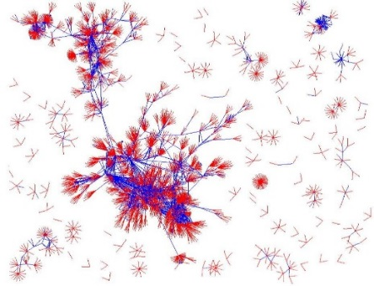
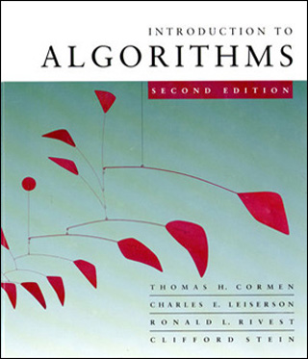
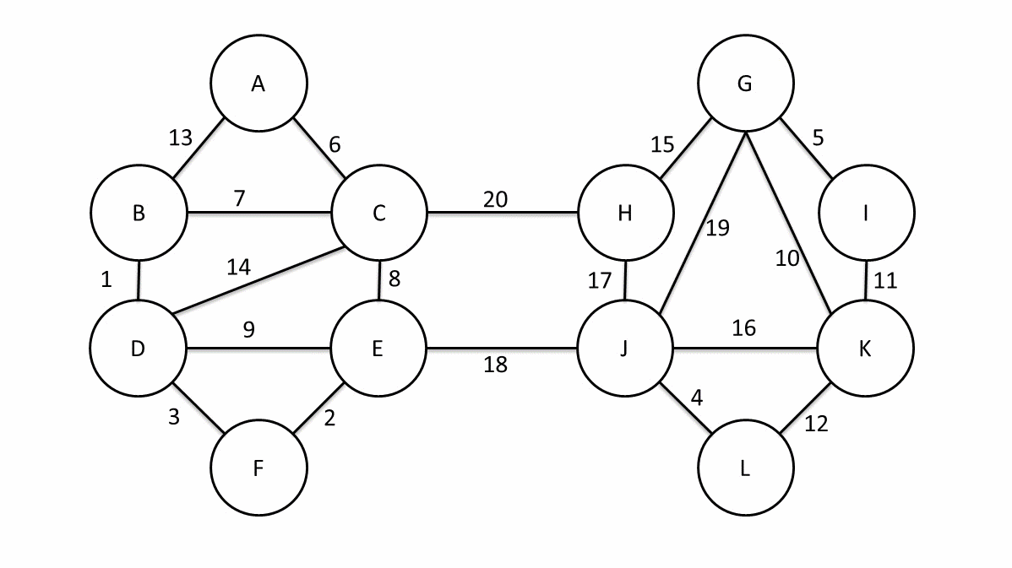
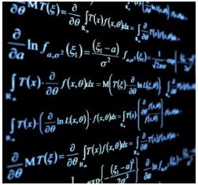
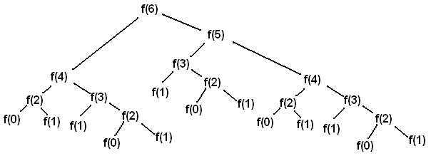
Layer 2: Algorithms
High-level math methods to perform the task: quick sort, search in graphs, fractal compression, signal encoding, etc.
Application
Algorithms
Programming Language
Operating System
Instruction Set Architecture
Microarchitecture
Gates/Register-Transfer (RTL)
Circuits
Physics

Slide 5


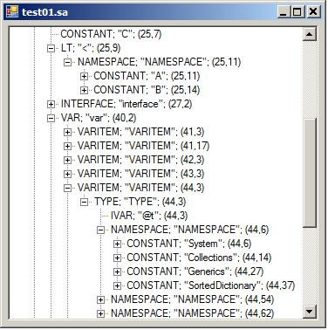
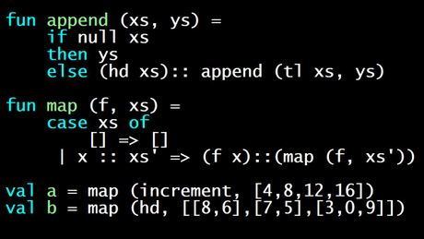
Level 3: Program Language
Representation of algorithms in formal languages that can be translated to “machine language”: C++, Java, Python, SQL etc.
Application
Algorithms
Programming Language
Operating System
Instruction Set Architecture
Microarchitecture
Gates/Register-Transfer (RTL)
Circuits
Physics

Slide 6
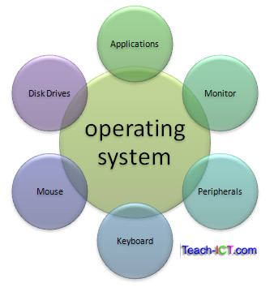
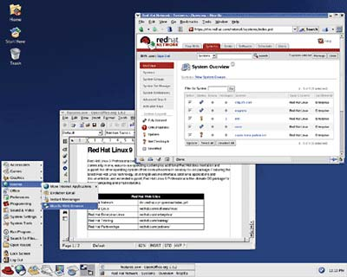


Level 4: Operating System
Manage computer resources and provides common interface for user programs: Unix, Window, iOS, Android, etc.
Application
Algorithms
Programming Language
Operating System
Instruction Set Architecture
Microarchitecture
Gates/Register-Transfer (RTL)
Circuits
Physics

Slide 7

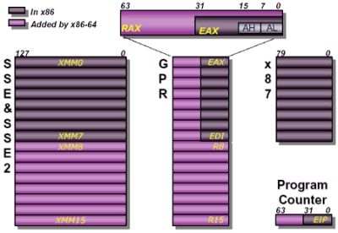


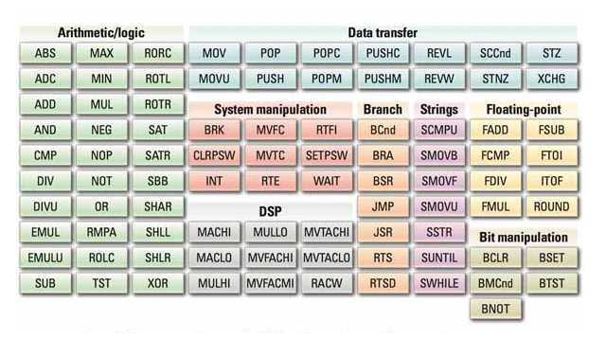
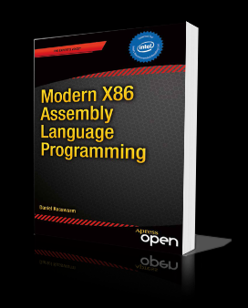

Level 5: Instruction Set Architecture (ISA)
Definition of “machine language” (commands) and available hardware structures/mechanisms: MIPS, x86, ARM, POWER etc.
Application
Algorithms
Programming Language
Operating System
Instruction Set Architecture
Microarchitecture
Gates/Register-Transfer (RTL)
Circuits
Physics

Slide 8
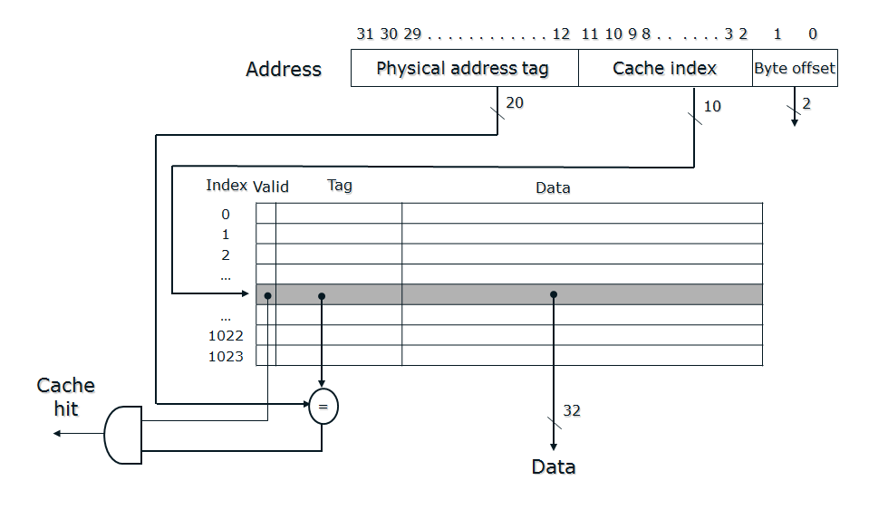
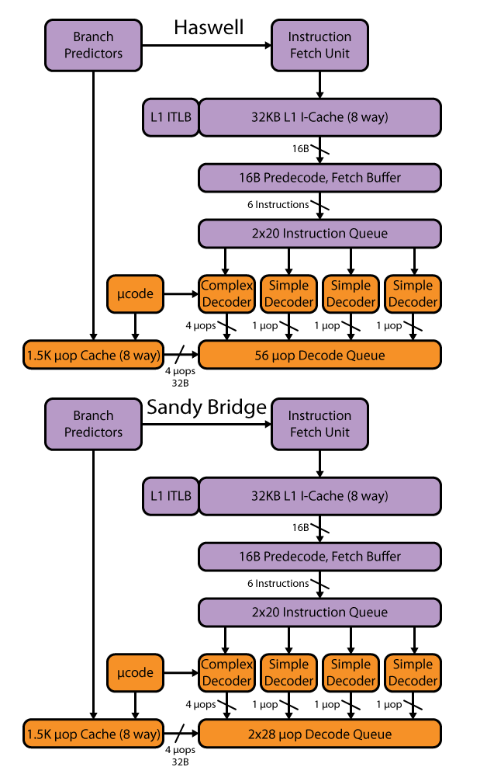
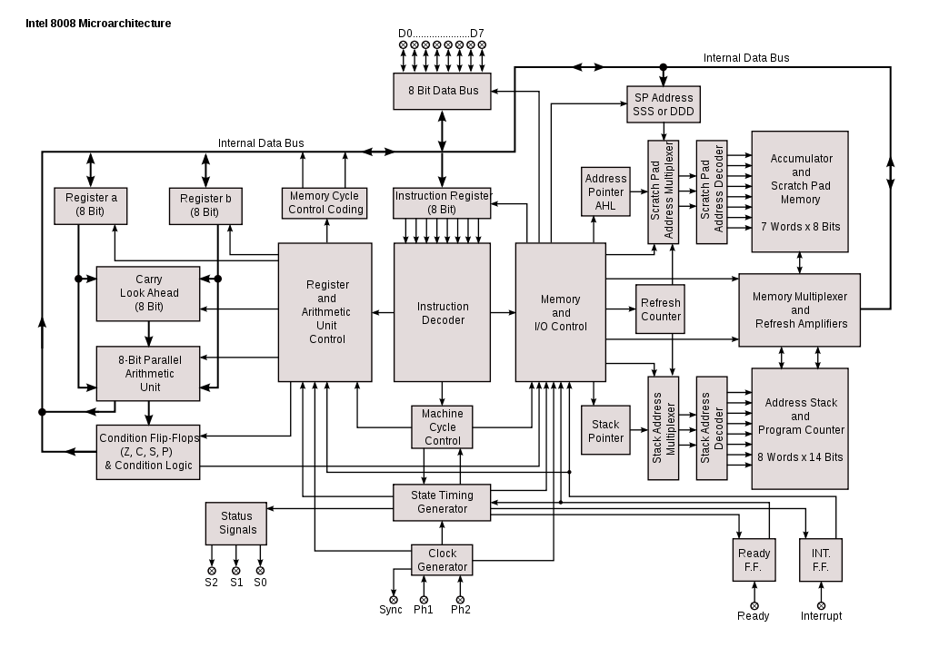
Level 6: Microarchitecture
High-level definition of hardware structures and operations: caches, buses, registers, pipeline, etc.
Application
Algorithms
Programming Language
Operating System
Instruction Set Architecture
Microarchitecture
Gates/Register-Transfer (RTL)
Circuits
Physics

Slide 9
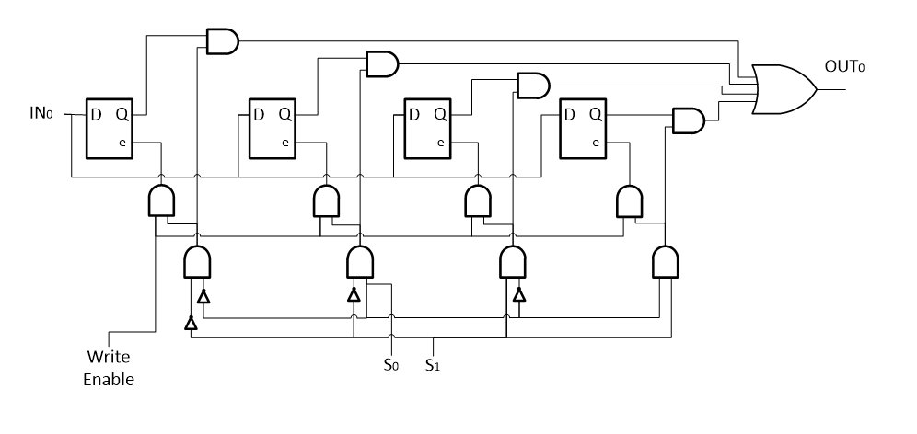
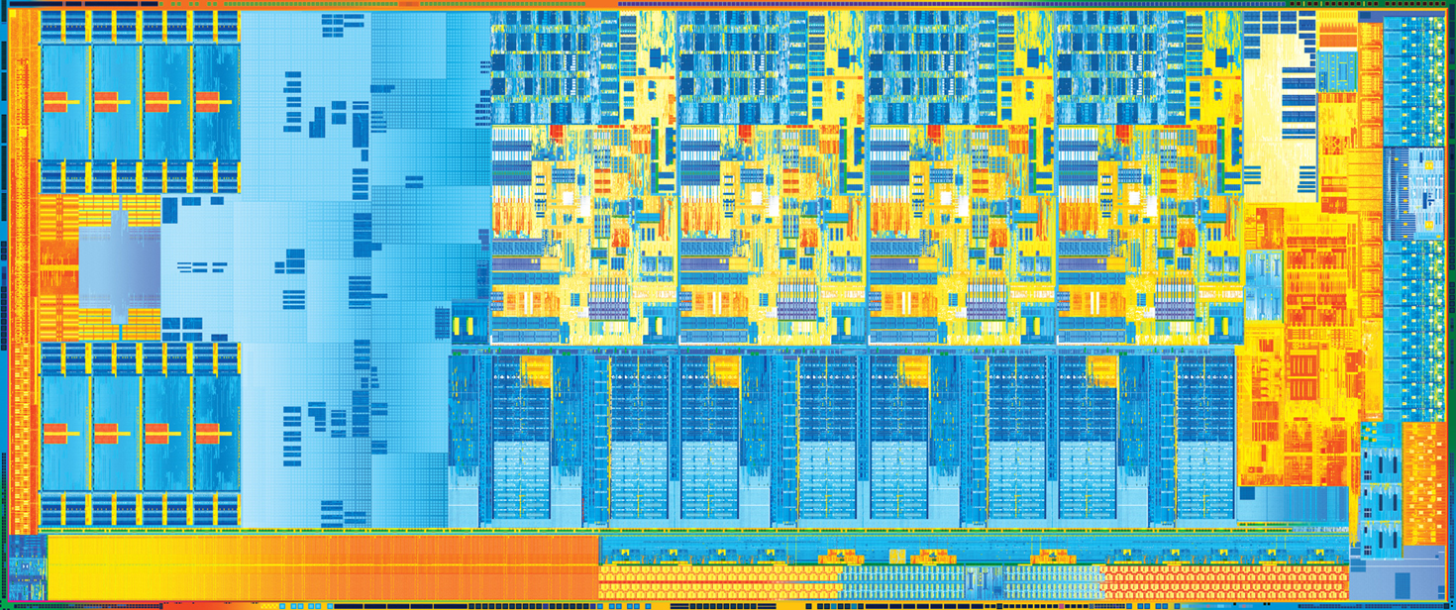
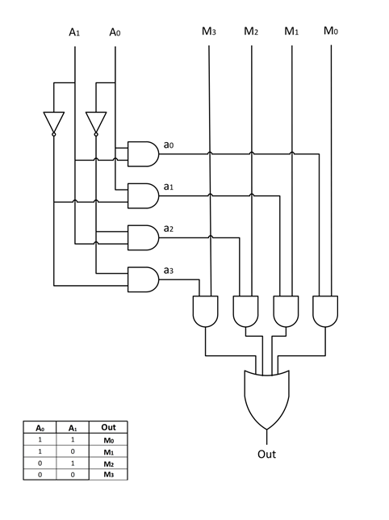
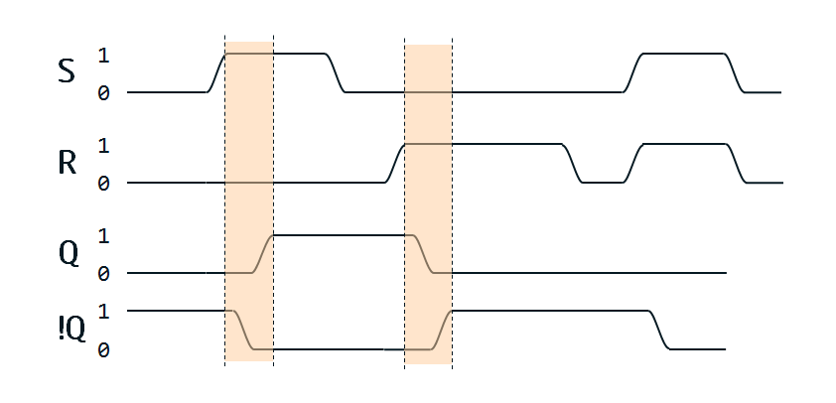
Level 7: Gates/RTL
Detailed definition of hardware: floor plan, wires, signal distribution, etc.
Application
Algorithms
Programming Language
Operating System
Instruction Set Architecture
Microarchitecture
Gates/Register-Transfer (RTL)
Circuits
Physics

Slide 10
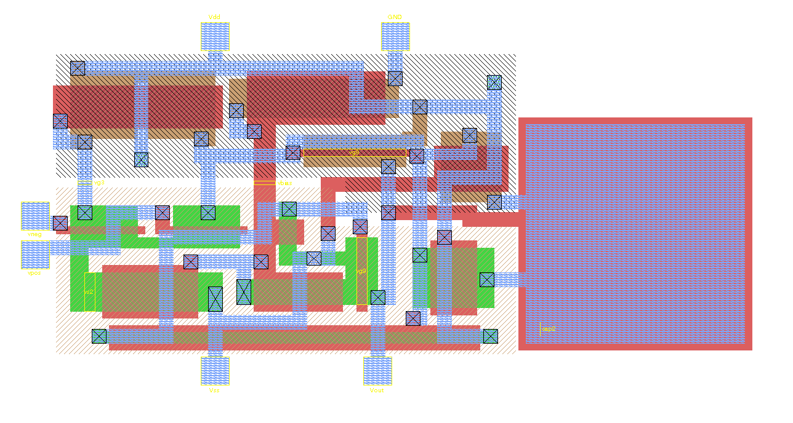
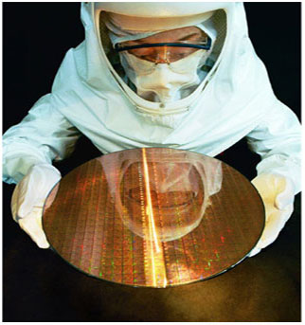
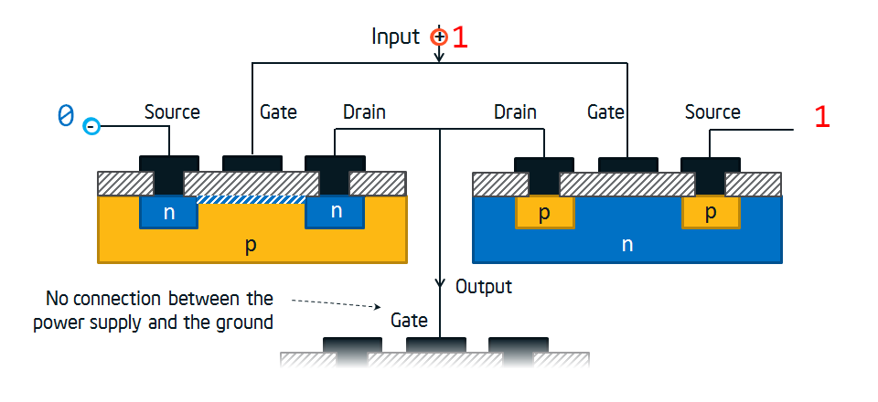
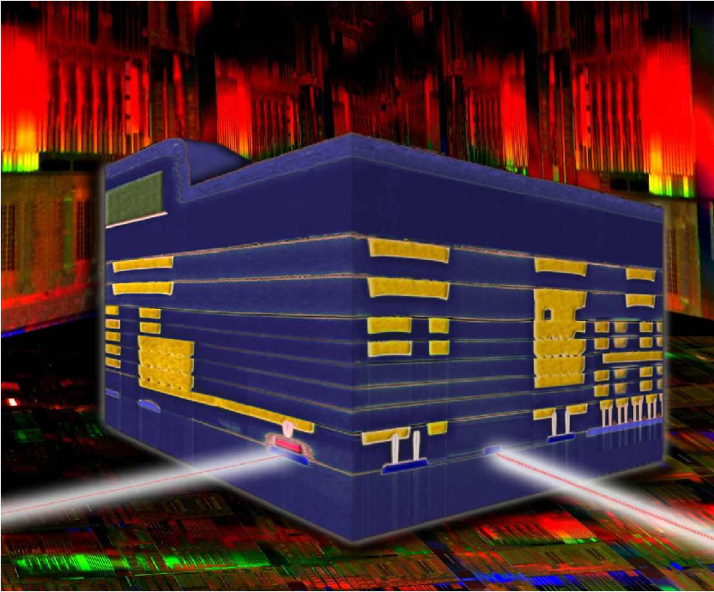
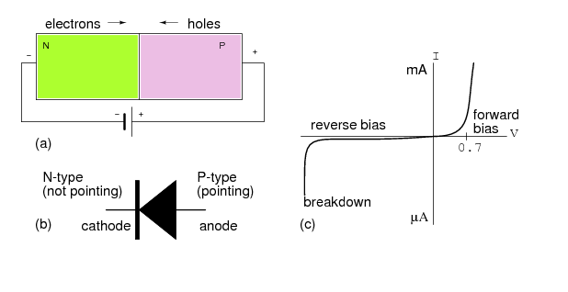
Level 8: Circuits
Structure and operation of base hardware elements: transistors, electricity effects (current, voltage, capacity, etc.)
Application
Algorithms
Programming Language
Operating System
Instruction Set Architecture
Microarchitecture
Gates/Register-Transfer (RTL)
Circuits
Physics

Slide 11
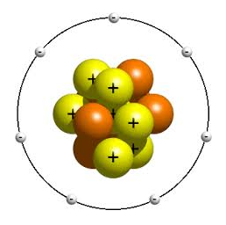
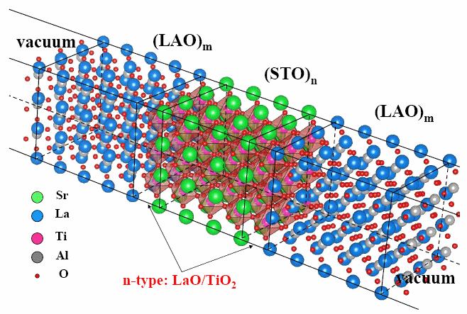
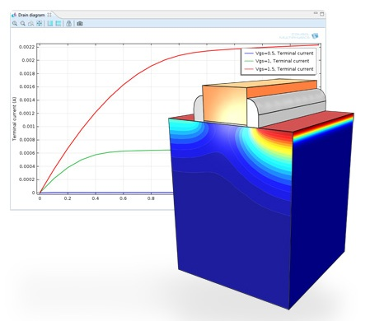
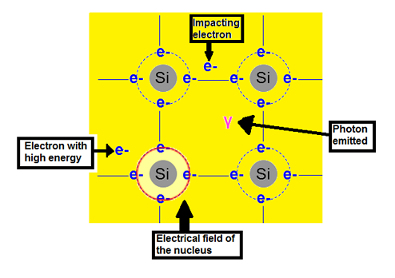
Level 9: Physics
Low level physics effects: material structure, diffusion of electrons, semiconductors, etc.
Application
Algorithms
Programming Language
Operating System
Instruction Set Architecture
Microarchitecture
Gates/Register-Transfer (RTL)
Circuits
Physics

Slide 12
Layers of Abstraction
Application
Application
Algorithms
Algorithms
Software (SW)
Programming Language
Programming Language
Computer Science
(CS)
Operating System
Operating System
Instruction Set Architecture
Instruction Set Architecture
HW/SW interface
Microarchitecture
Microarchitecture
Gates/Register-Transfer Level (RTL)
Gates/Register-Transfer Level (RTL)
Hardware (HW)
Electrical Engineering
(EE)
Circuits
Circuits
Physics
Physics

Slide 13
Course focus
We will focus our attention mostly on the microarchitecture, but also look through the ISA and the HW levels
Instruction Set Architecture
Microarchitecture
The most focus is here
Gates/Register-Transfer Level (RTL)
Circuits
Physics

Slide 14
Performance, Power, Cost

Slide 15
Basic Design Tradeoffs
Performance
(speed)
Cost
(complexity, area)
Power
(energy consumption and dissipation)
All three are very important
It is extremely hard to create a feature that improves all factors
Different products (mobile, desktop, etc.) require different balance

Slide 16
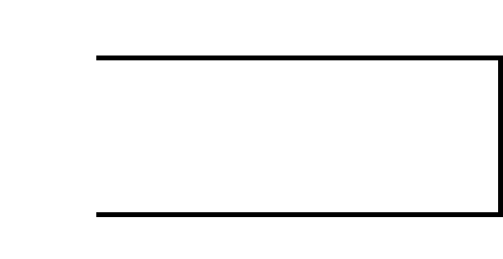
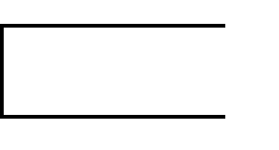
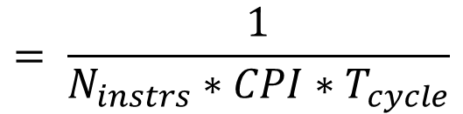
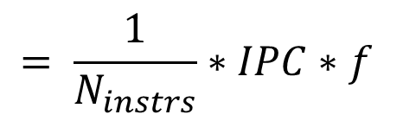
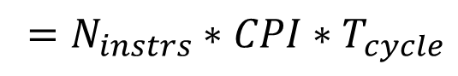
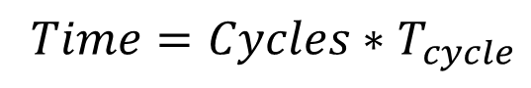
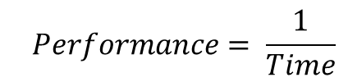
Performance
What does performance depend on?
$$Performance= \frac{1}{Time}$$
$$= \frac{1}{N_{instrs}∗CPI∗T_{cycle}}$$
$$= \frac{1}{N_{instrs}}∗IPC∗f$$
$$Time=Cycles∗T_{cycle}$$
$$=N_{instrs}∗CPI∗T_{cycle}$$
Golden rule of CS

Slide 17
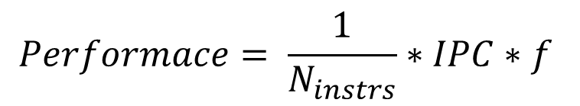
Increasing Performance
How can we increase it?
Better SW: algorithms, optimizations, ISA, etc.
Better CD: faster circuits, smaller transistors, etc.
$$Performace= \frac{1}{N_{instrs}}∗IPC∗f$$
Better uArch: pipelining, caching, prediction, etc.
But, need better CD to enable these approaches
(e.g., more transistors)

Slide 18
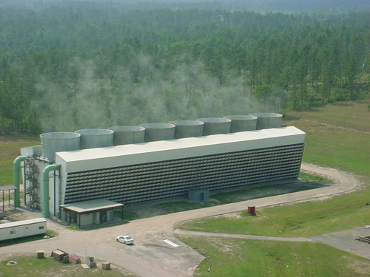
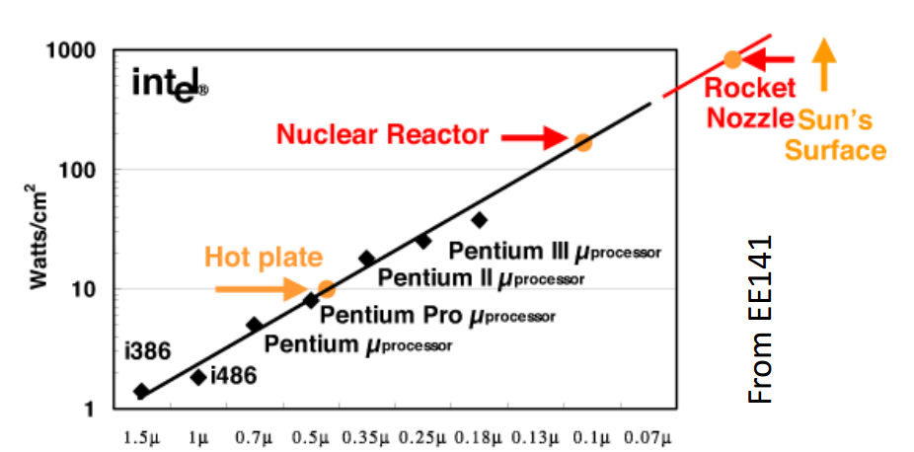
Power
Nuclear reactor? No, power supply for a large data center
Why is power important?
Less power -> smaller battery -> smaller/cheaper devices
Less power -> less money for electricity
Power Wall is reached
The maximum power dissipation that cooling systems can handle is reached
We cannot spend more power even if we want

Slide 19
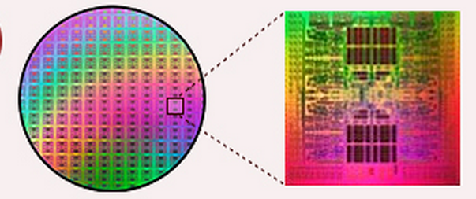
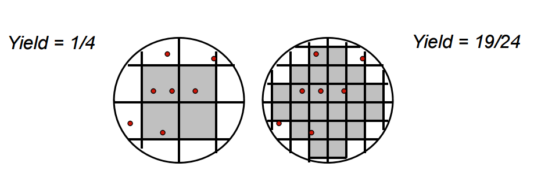
Cost
Fixed Cost (RnD)
Independent of volume (i.e., number of units made/sold)
Examples: design time and effort, mask generation, etc.
Variable Cost (manufacturing/production)
proportional to volume
Examples: silicon processing, packaging, test
Most of these related to chip area
The larger chip size the large production cost
Less chips on one wafer
Larger probability of error

Slide 20
ISA and uArch

Slide 21
ISA and uArch
Instruction Set Architecture (ISA) is a precise definition of computer instructions, features and mechanism (procedures, interrupt/exception handler, etc.) and also some structures (registers, memory, etc.)
It can be thought as an agreement between a programmer and an engineer:
It’s all programmer needs to program machine.
It’s all hardware designer needs to design machine.
Microarchitecture (uArch, implementation) is an organization and features of Hardware that executes instructions and support features defined in the ISA.

Slide 22
ISA and uArch
What a typical ISA defines
Data Formats. (Integer, Floating Point, Vector/Packed)
Instructions. (Operations, encoding, etc.)
Registers and Memory Organization.
Interrupts, exceptions, and traps.
Implementation-Dependent Features. (Memory control, custom features.)
What a typical uArch defines (not included into ISA)
Memory hierarchy organization (caches, buses, etc.)
Pipeline (forwarding, branch prediction, etc.)
Out-of-order executions … and many others.
they change the state
the programmer-visible state

Slide 23
Example: MIPS
An example of a RISC processor.
Designed for easy programming and implementation.
Short and simple, but fast instructions → programs are larger than others, but run faster.
The main aim was to take advantages of pipelined execution
Pipeline was not specified in ISA, but ISA developers tried to simplify its implementation in uArch.
Implementations:
The first one is R2000 (1986)
Later: R3000A (PlayStation), R4000 (PSP), R5900 (PlayStation 2), etc.
Currently it is widely used in embedded systems.
One moment MIPS seemed to be overcome Intel IA-32, but it didn’t happen because Intel’s uArch was significantly better and could compensate the drawback of IA-32.
One moment MIPS seemed to be overcome Intel I but it didn’t happen because Intel’s uArch was significantly better and could compensate the drawback of IA-32.

Slide 24
Data Formats
In the memory all including data and program code is presented as binary numbers:
Data representation:
Sizes: 8-b Bytes, 16-b Half words, 32-b words and 64-b double words (not considered in this course)
Formats: signed/unsigned integer, signed/unsigned floating point (not considered in this course)
0000 0010 | 0011 0010 | 0100 0000 | 0010 0000
=
=
0x2012620
add $t0, $s1, $s2

Slide 25
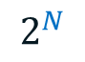
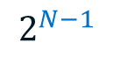
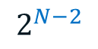
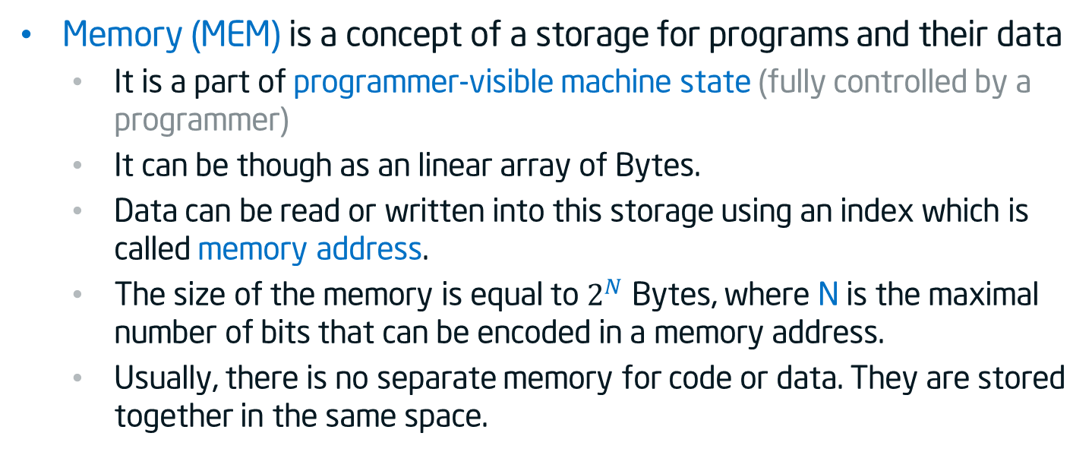
Memory addressing
Memory (MEM) is a concept of a storage for programs and their data
It is a part of programmer-visible machine state (fully controlled by a programmer)
It can be though as an linear array of Bytes.
Data can be read or written into this storage using an index which is called memory address.
The size of the memory is equal to $2^{N}$ Bytes, where N is the maximal number of bits that can be encoded in a memory address.
Usually, there is no separate memory for code or data. They are stored together in the same space.
0
1
2
$$2^{N−2}$$
$$2^{N−1}$$
$$2^{N}$$
…
00100100
…
…
…
…
…
8 bits = 1 Byte

Slide 26

Big and Little Endian
Historically numbers are being written from the right to the left (the most significant digit is on the right):
However, we used to enumerate elements in an array (and most other things) from the left to the right:
The question: if we put an value of two bytes (e.g. 256) at the beginning of the array where the most significant byte will be? In element 0 or element 1?
Decimal 537 = 7*${\text{10}}^{0}$ + 3*${\text{10}}^{1}$ + 5*${\text{10}}^{2}$
Decimal 537 = 7*${\text{10}}^{0}$ + 3*${\text{10}}^{1}$ + 5*${\text{10}}^{2}$
Binary 1101 = 1*${\text{2}}^{0}$ + 0*${\text{2}}^{1}$ + 1*${\text{2}}^{2}$ + 1*${\text{2}}^{3}$
Binary 1101 = 1*${\text{2}}^{0}$ + 0*${\text{2}}^{1}$ + 1*${\text{2}}^{2}$ + 1*${\text{2}}^{3}$
0
1
2
$$2^{N−2}$$
$$2^{N−1}$$
$$2^{N}$$
…
…
…
…
…
…
…

Slide 27
Big and Little Endian
The answer: it depends on the ending which is defined in the ISA.
Most significant byte
Least significant byte
Decimal 256 = Binary 0000 0001 | 0000 0000
Decimal 256 = Binary 0000 0001 | 0000 0000
Decimal 256 = Binary 0000 0001 | 0000 0000
15
8
7
0
Big Endian
Little Endian
0
1
2
0
1
2
00000001
00000000
00000000
10000000
15
8
0
7
7
0
8
15
The ISA of our host machines in the lab (x86) and MIPS ISA that we will simulate both assume Little Endian

Slide 28
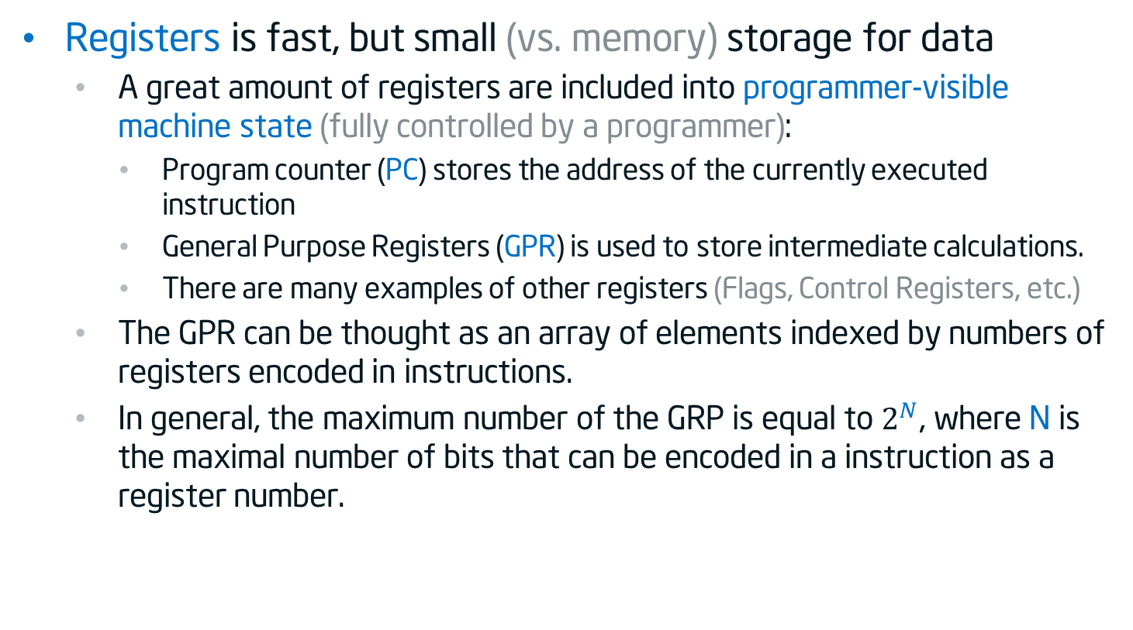
Registers
Registers is fast, but small (vs. memory) storage for data
A great amount of registers are included into programmer-visible machine state (fully controlled by a programmer):
Program counter (PC) stores the address of the currently executed instruction
General Purpose Registers (GPR) is used to store intermediate calculations.
There are many examples of other registers (Flags, Control Registers, etc.)
The GPR can be thought as an array of elements indexed by numbers of registers encoded in instructions.
In general, the maximum number of the GRP is equal to $2^{N}$, where N is the maximal number of bits that can be encoded in a instruction as a register number.

Slide 29
Operations
Common types:
Set a register to constant value or value of other register (move operation).
Loads (memory → register ) & stores (register ← memory)
Read and write data from hardware devices (I/O) – not used in our project
Arithmetic and Logic:
+, -, *, /, =. . .
And, Or, Xor, Not
Compare two values of registers
Control flow (taking decision: loops, if-else)
branch to another location (set new value into PC)
conditionally branch (if (condition) then PC new value)
save current location and jump to new location (Procedure call)

Slide 30
Acknowledgements
These slides contain material developed and copyright by:
Krste Asanovic (MIT/UCB), CS152-L1
David M. Koppelman (LSU), EE4720-L1

Slide 31
Thank You

